Slide 1
Programming Fundamentals
By
Shazmeen Batool

Slide 2
Previous Lecture
Ternary Operator
Switch in C++

Slide 3
Today’s Lecture
Random Numbers in C++

Slide 4
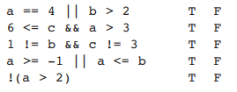
Class Activity
Assume the variables a = 2, b = 4, and c = 6. Indicate by circling the T or F if each of the following conditions is true or false:

Slide 5
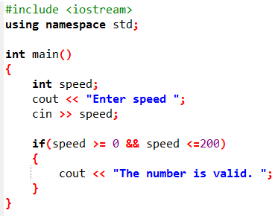


Class Activity
Write an if statement that prints the message “The number is valid” if the variable speed is within the range 0 through 200.

Slide 6

Class Activity
Write an if statement that prints the message “The number is not valid” if the variable speed is outside the range 0 through 200.

Slide 7
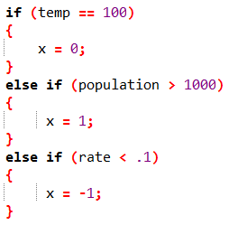
Class Activity
Explain why you cannot convert the following if/else if statement into a switch statement.
1. Switch statements can't handle multiple variables in one switch; they only work on one at a time.
2. Switch doesn't support logical operators.
3. Switch works with integers, characters, or enums, but not directly with floating-point numbers.

Slide 8
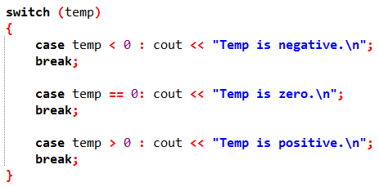
Class Activity
What is wrong with the following switch statement?
1. Invalid Case Labels.
2. You can't use operators like <, ==, or > in case labels.

Slide 9
Random Numbers
Random numbers are useful for lots of different programming tasks. The following are just a few examples:
Random numbers are commonly used in games. For example, computer games that let the player roll dice use random numbers to represent the values of the dice.
Random numbers are useful in simulation programs. In some simulations, the computer must randomly decide how a person, animal, insect, or other living being will behave. Formulas can be constructed in which a random number is used to determine various actions and events that take place in the program.

Slide 10
Random Numbers
Random numbers are useful in statistical programs that must randomly select data for analysis.
Random numbers are useful in statistical programs that must randomly select data for analysis.
The C++ library has a function, rand(), that you can use to generate random numbers. (The rand() function requires the cstdlib header file.) The number returned from the function is an int.

Slide 11
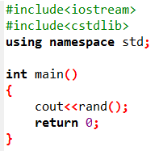

Example
Output:

Slide 12
Random Numbers
After this statement executes, the variable y will contain a random number.

Slide 13
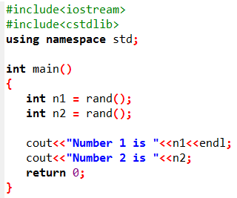

Example
Output:

Slide 14
Random Numbers
To obtain a random integer between 0 and 9, use rand() % 10
To obtain a random integer between 0 and 99, use rand() % 100

Slide 15
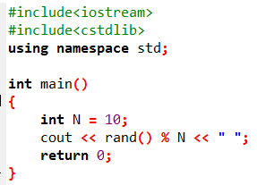

Example
Output:

Slide 16

Random Numbers
In actuality, the numbers produced by rand() are pseudorandom. The function uses an algorithm that produces the same sequence of numbers each time the program is repeated on the same system.
For example, suppose the following statements are executed.
The three numbers displayed will appear to be random, but each time the program runs, the same three values will be generated.

Slide 17
Example
Output:
Note: If random numbers are generated with rand() without first calling srand(), your program will create the same sequence of numbers each time it runs.

Slide 18
srand()
In order to randomize the results of rand(), the srand() function must be used.
srand() accepts an unsigned int argument, which acts as a seed value for the algorithm.
By specifying different seed values, rand() will generate different sequences of random numbers.

Slide 19
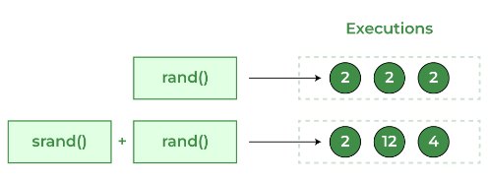
Comparison

Slide 20
srand()
A common practice for getting unique seed values is to call the time function, which is part of the standard library.
The time function gives you a number based on the current date and time, which changes every second. This means each run of your program is likely to get a different seed, leading to different random results.
The time function requires the ctime header file, and you pass 0 as an argument to the function.
srand(time(0))

Slide 21
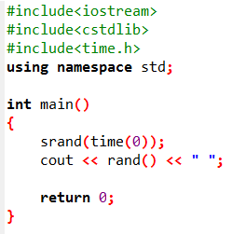
Example

Slide 22
Activity
The program may be set up to work as follows:
Step 1: Generate two single-digit integers into number1 and number2.
Step 2: Ask user to enter y if he/she wants to play this game.
Step 3: if user enters yes Prompt the user to answer “What is number1 + number2?”
Step 4: Check the student’s answer and display whether it is correct. If user guess correct answer, display Congratulations otherwise print sorry

Slide 23
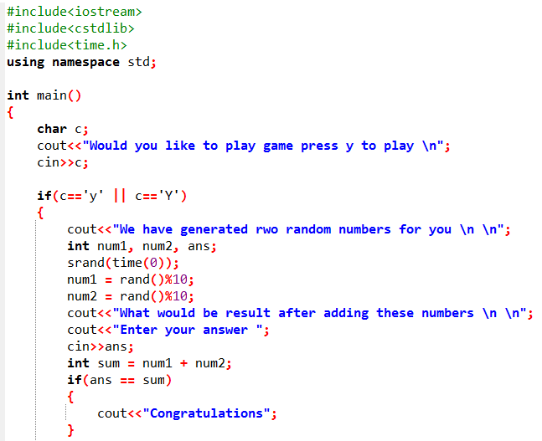

Slide 24
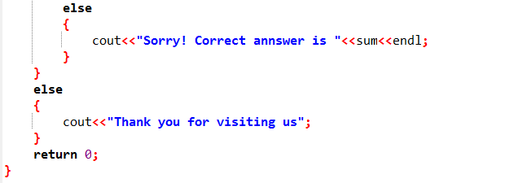

Slide 25
Generating random number between lower and upper bound
Example:
Generating random numbers between 1 and 6 where 1 = minimum value and 6 = maximum value
Formula
(rand() % (maximum value - minimum value + 1)) + minimum value

Slide 26
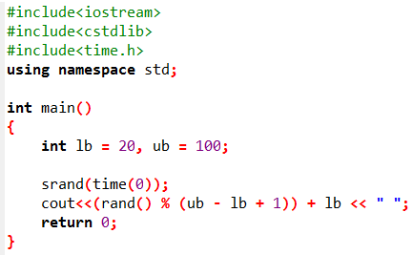
Example

Slide 27
Tasks
Which of the following is a possible output from invoking rand()?
323.4, 5, 34, 1, 0.5, 0.234

Slide 28
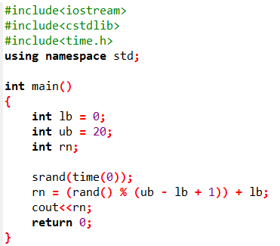
Tasks
How do you generate a random integer i such that
0<=i <=20?

Slide 29
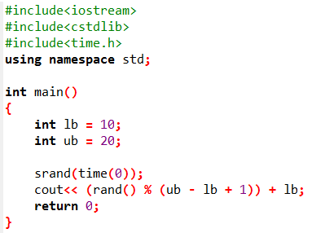
Tasks
How do you generate a random integer i such that
10<=i<=20?

Slide 30
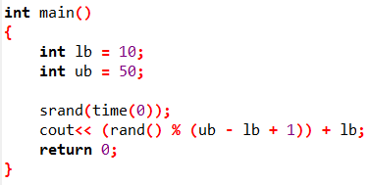
Tasks
How do you generate a random integer i such that
10 <=i<=50?

Slide 31
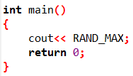
Tasks
Find out what RAND_MAX is on your machine.
The constant RAND_MAX is the maximum value that can be returned by the rand function.

Slide 32
Task
Write a program which ask user to generate a random number between 1 and 3 and print apple if random number is 1, prints, grapes if random number is 2 print orange and prints peach if number is 3
(Note: Use switch)

Slide 33
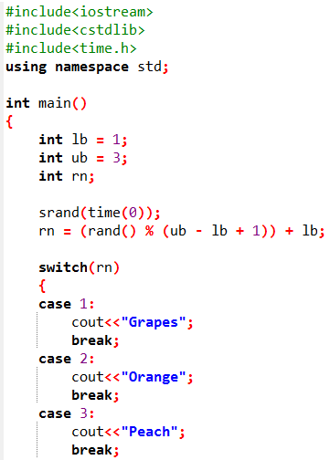

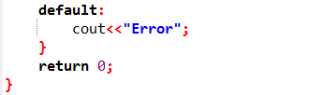
Output:

